Slide 1
MedPoint
DermAppoint
Nesif Pinduruan
Adrianne Cabuenas
Khira Dianne Orcullo

Slide 2
Project Details
DermAppoint
A system for patients to book dermatology appointments and for clinic administrators to manage appointments, services, and patient records.
  Target Users
Patients: Individuals seeking dermatology appointments.
Clinic Administrators: Staff who manage appointments, services, and patient data.

Slide 3
Project Features
The system includes the following GUI windows:
Welcome / Login Window – For patient and admin login/signup.
Patient Dashboard – Main interfaces for patients.
Admin Dashboard – Main interfaces for administrators.
Appointment Booking Form – For booking new appointments.
Appointment Management Panel – For viewing and managing appointments.
Services Management Panel – For admins to add/edit/delete services.
Patient Records Panel – For admins to view patient history.

Slide 4
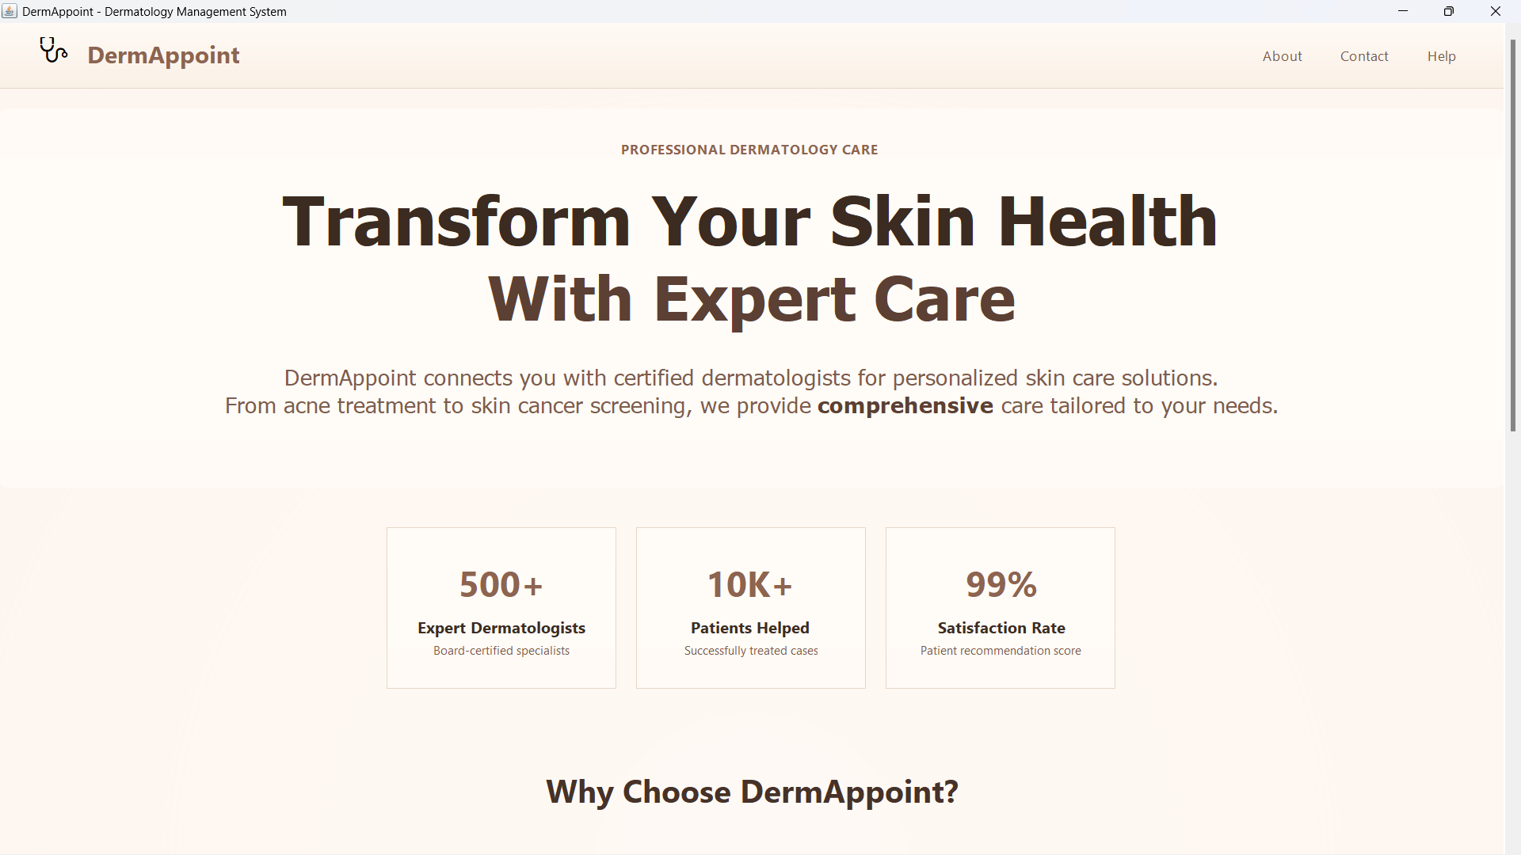
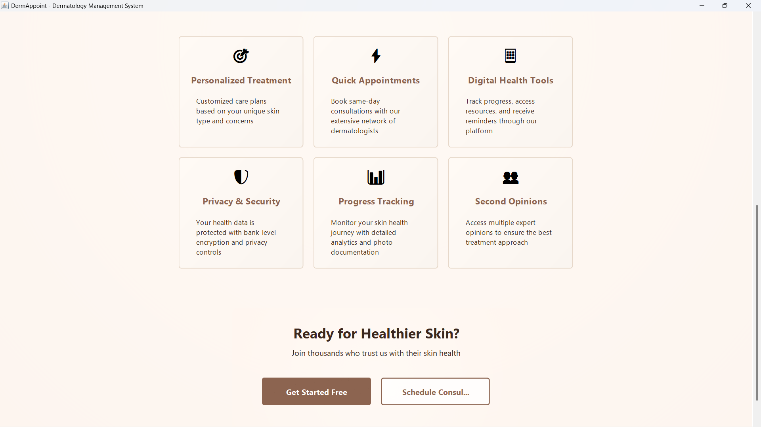
Welcome Panel
their life easier

Slide 5
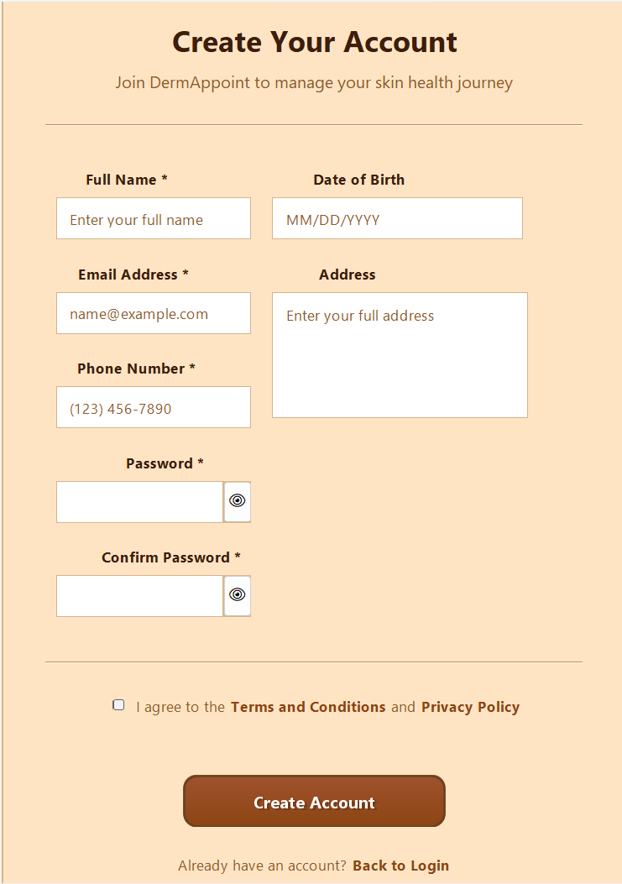
Sign up Panel
their life easier

Slide 6
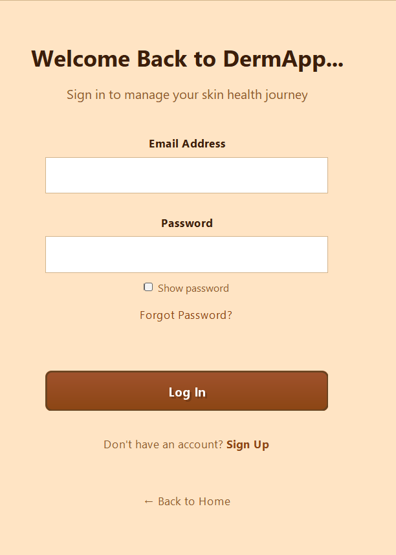
Log in Panel
their life easier

Slide 7
Patient’s Dashboard
Patient Sees:
MAIN FEATURES
Profile Settings (Edit name, birthdate, contact, email, location)
Log Out
Book Appointment
Book for Another Person (No account needed)
View Services
My Appointments
  View details:
  (name, service, date/time, status — approved/declined/rescheduled)
  Past Appointments
  Cancel Appointment

Slide 8
Admin’s Dashboard
Admin Sees:
Manage Appointments
  View all appointments
  Approve / Decline
  Reschedule
Add Appointment (Walk-in or No-Account patients)
View Patient Records
  Patient info
  Appointment history
View Services
  Add Service
  Edit Service
  Delete Service
Admin Account Settings (Edit name, birthdate, contact, email, location)
Log Out

Slide 9
Thank you

